Slide 1
Decision Tree - Regression
Example

Slide 2
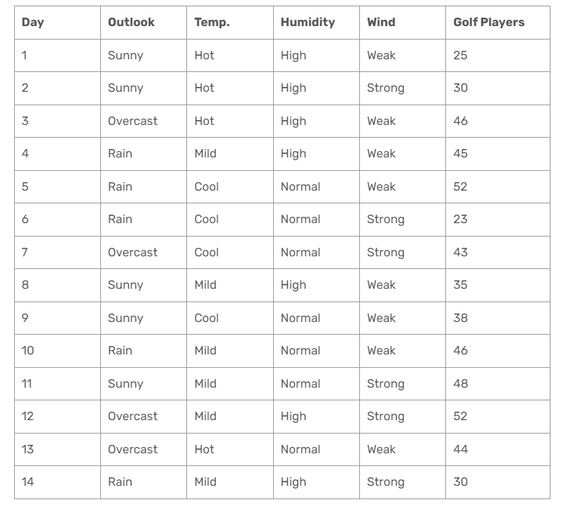
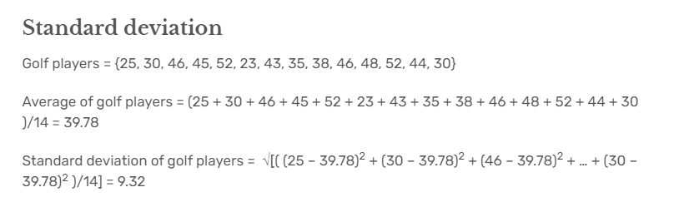

Slide 3
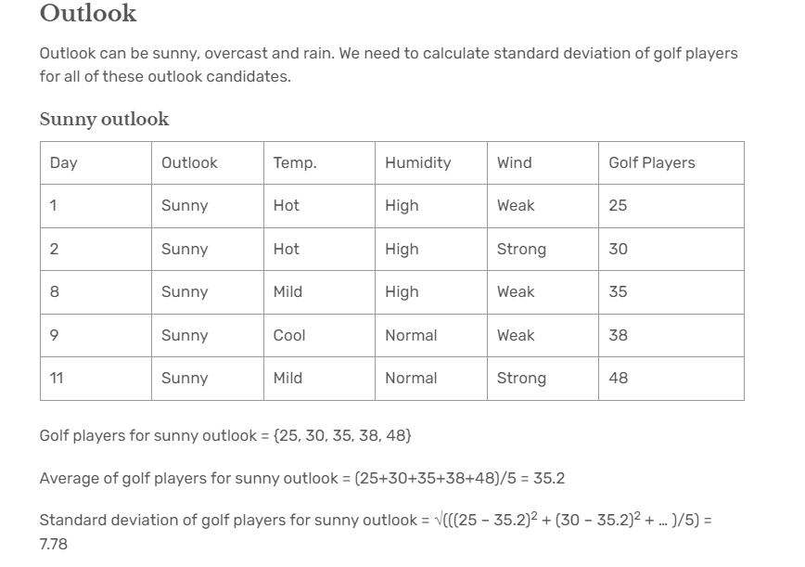

Slide 4
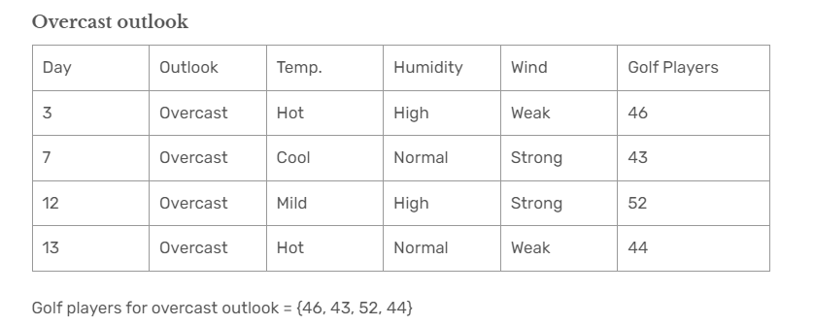
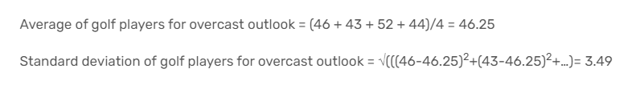

Slide 5
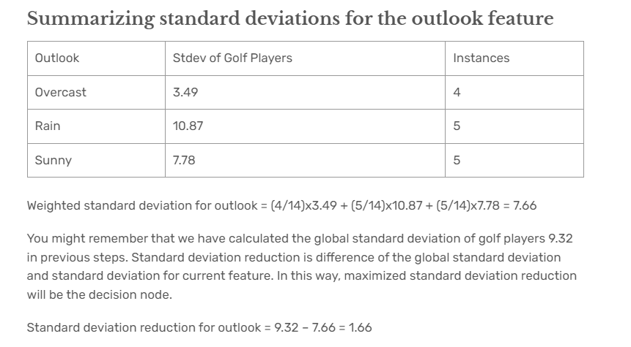

Slide 6
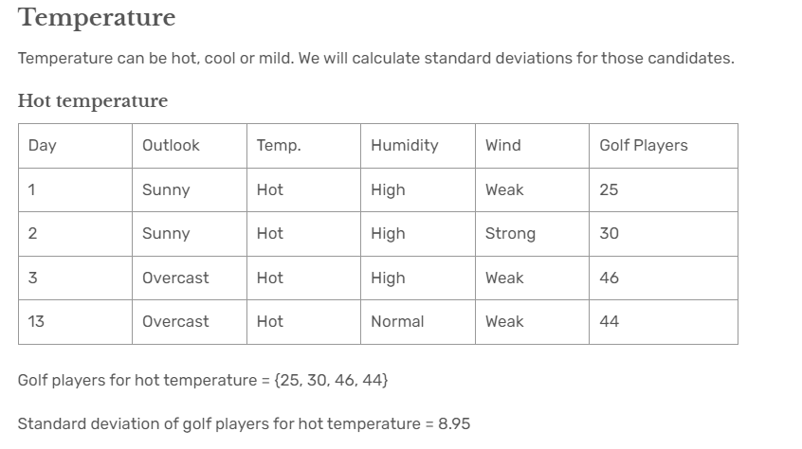

Slide 7
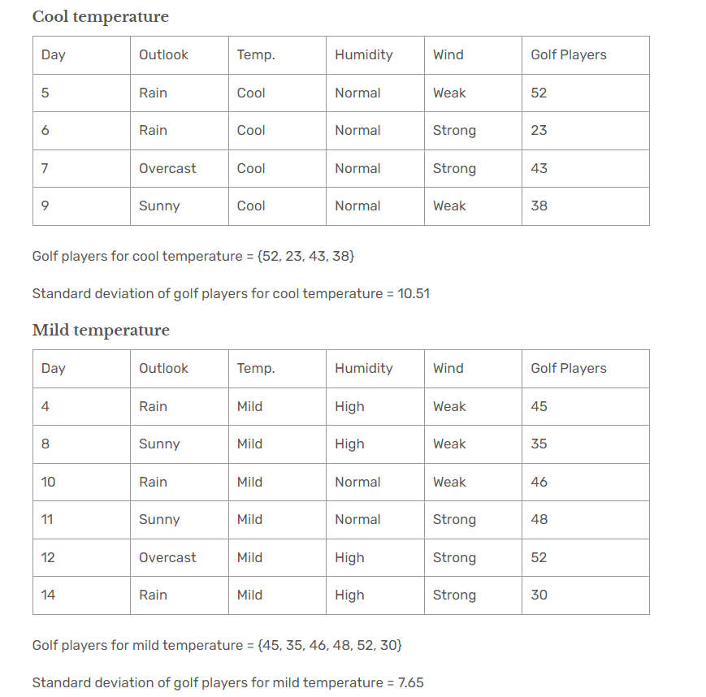

Slide 8
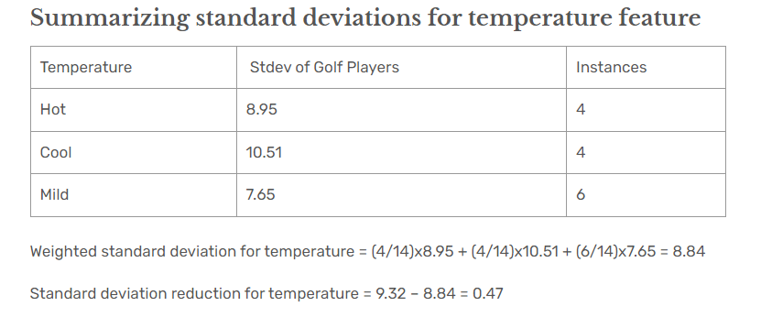

Slide 9
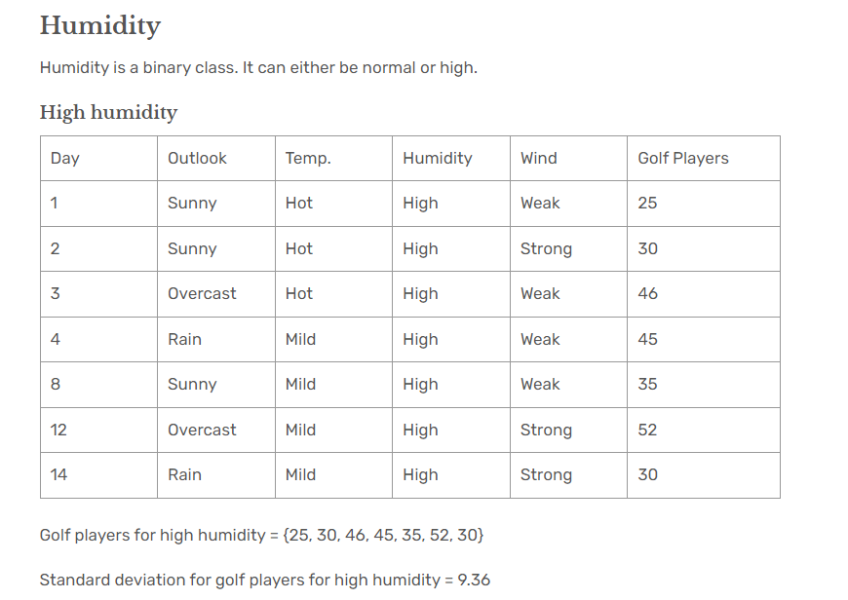

Slide 10
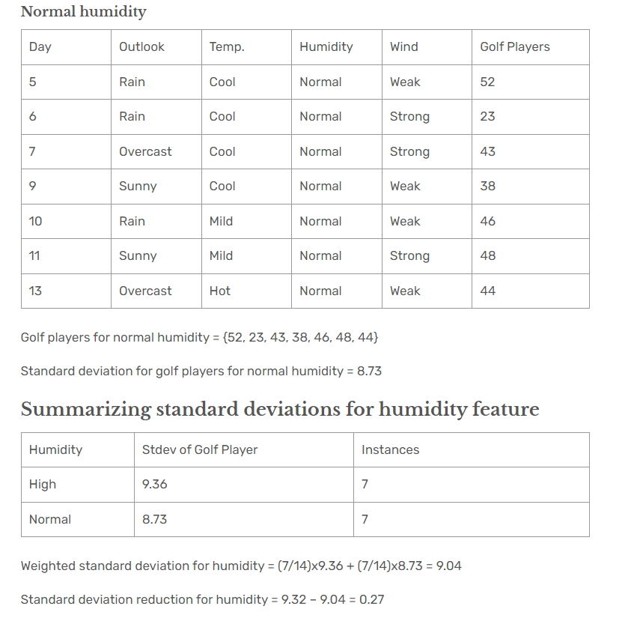

Slide 11
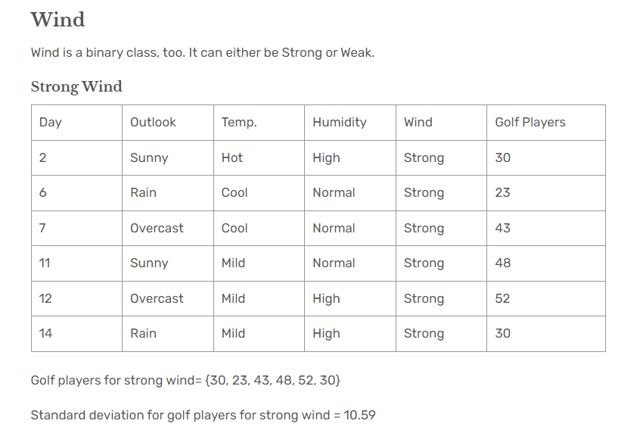

Slide 12
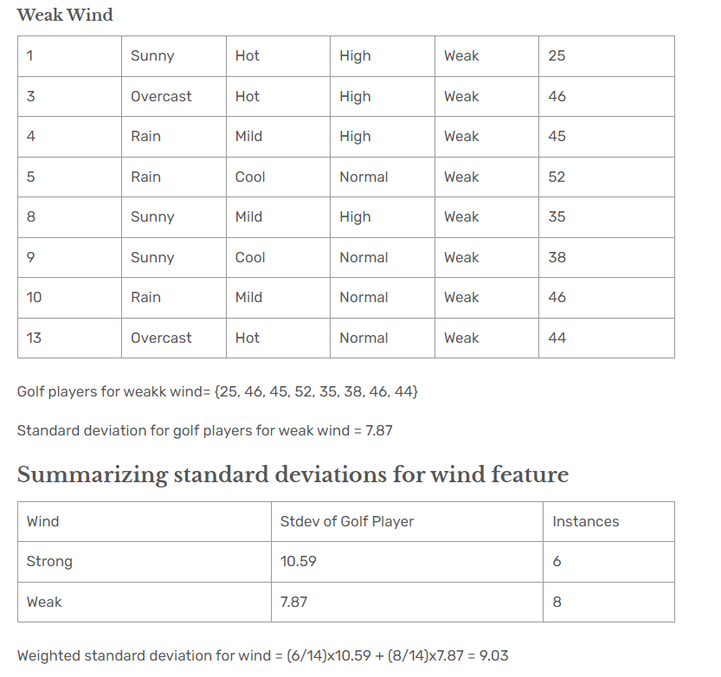

Slide 13
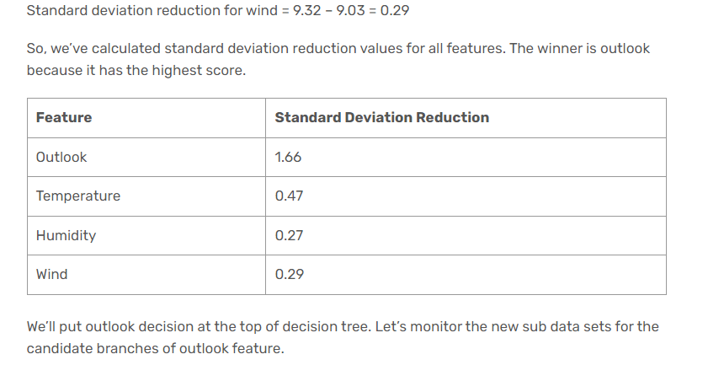
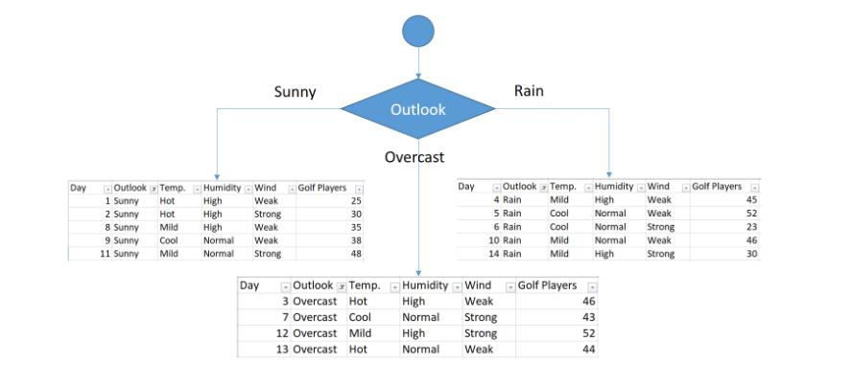

Slide 14
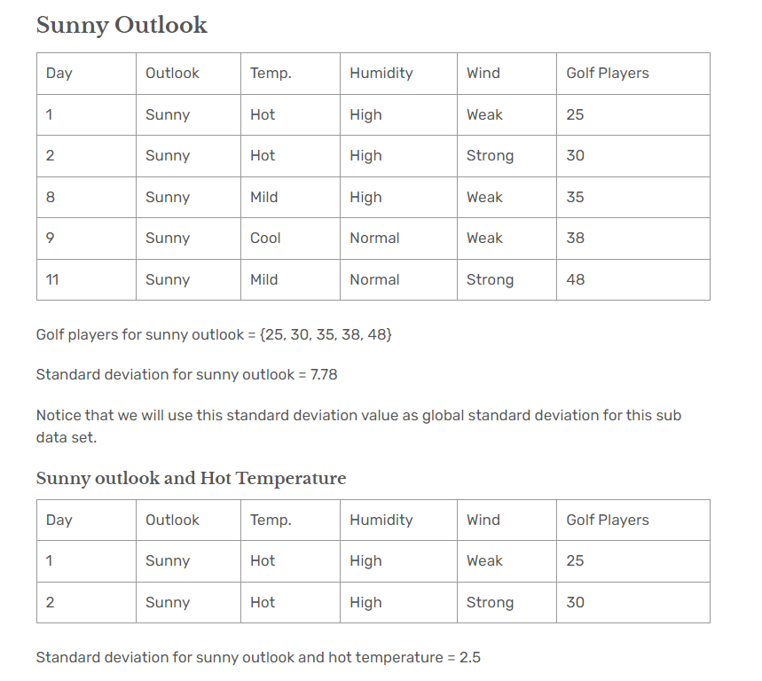

Slide 15
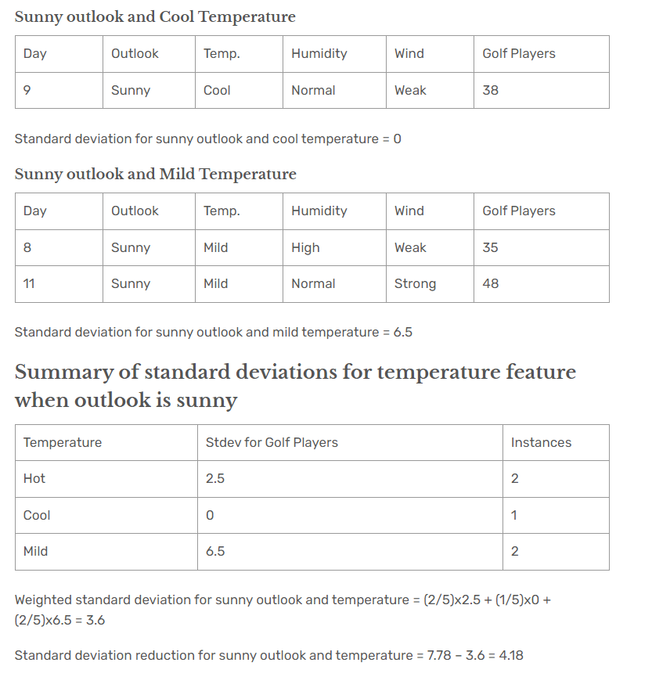

Slide 16
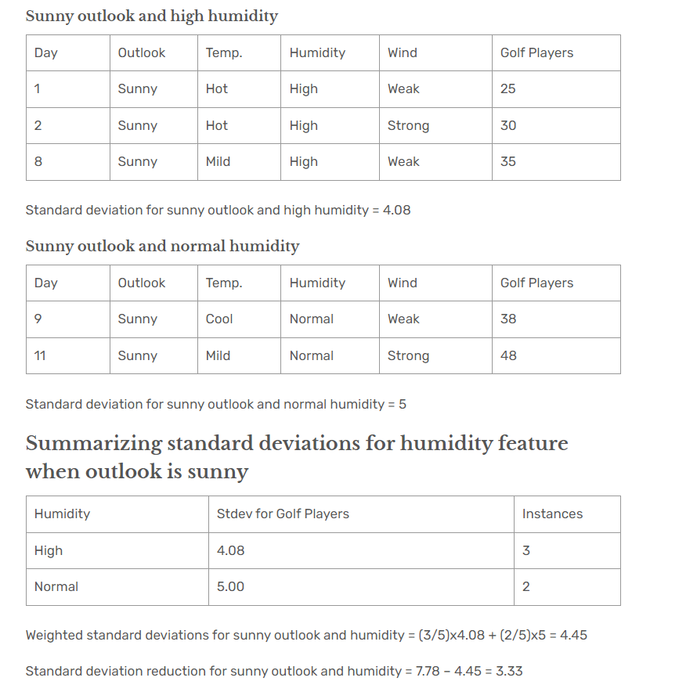

Slide 17
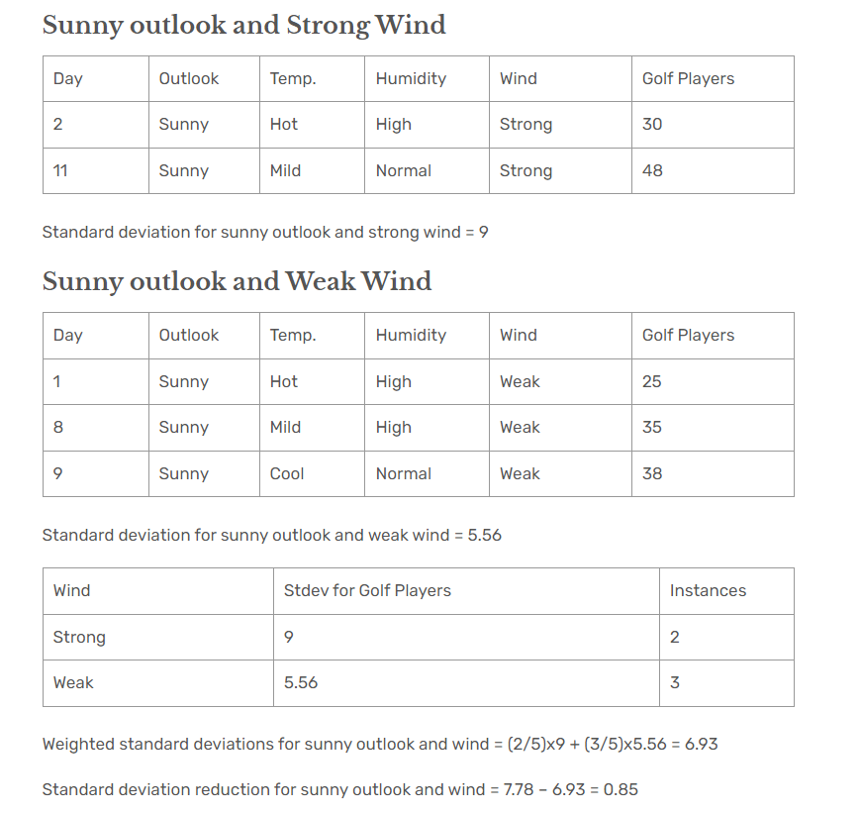

Slide 18
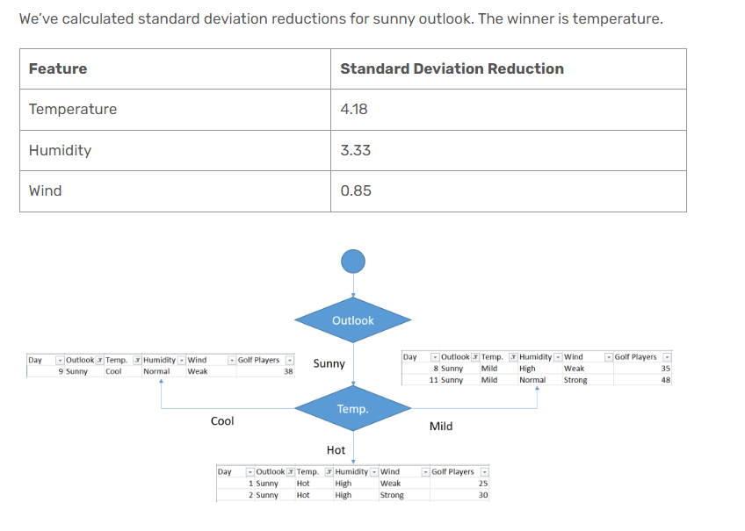

Slide 19
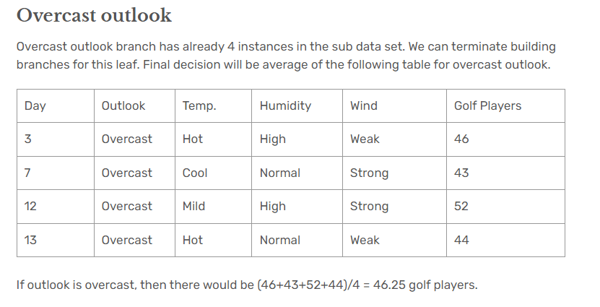

Slide 20
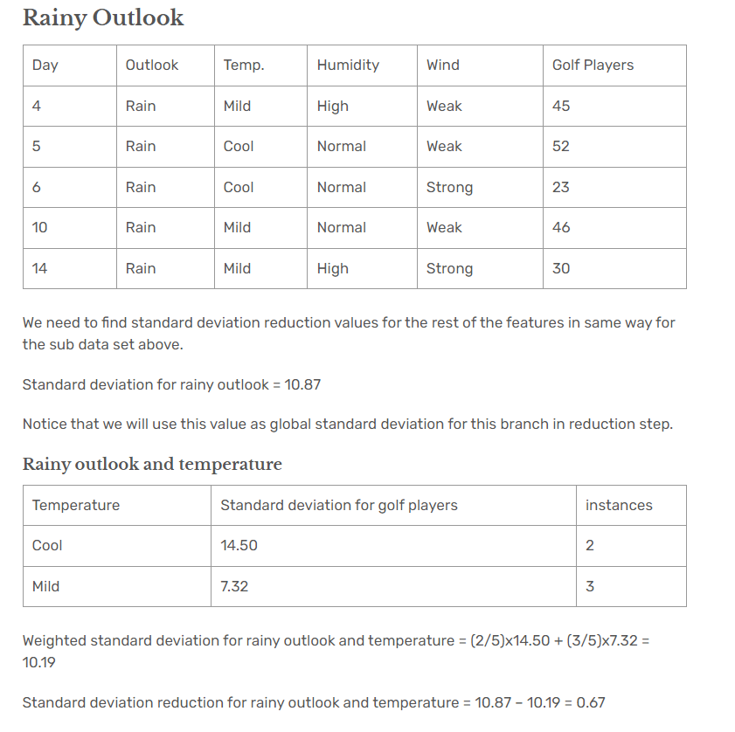

Slide 21
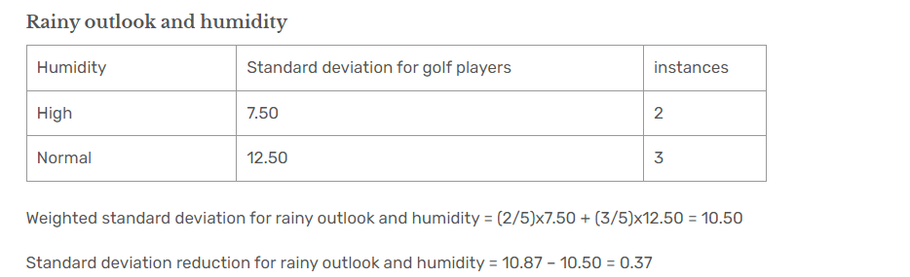

Slide 22
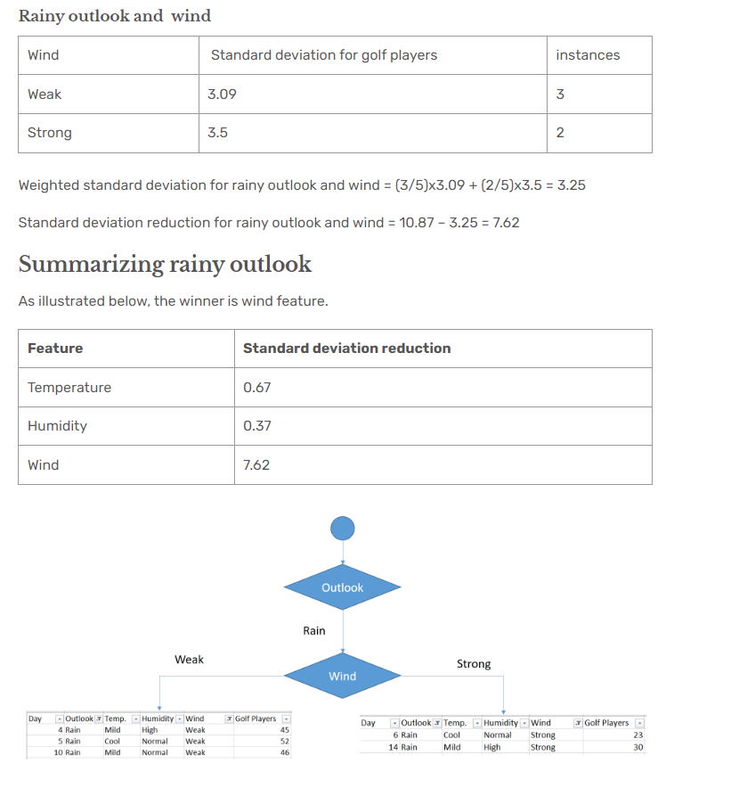

Slide 23
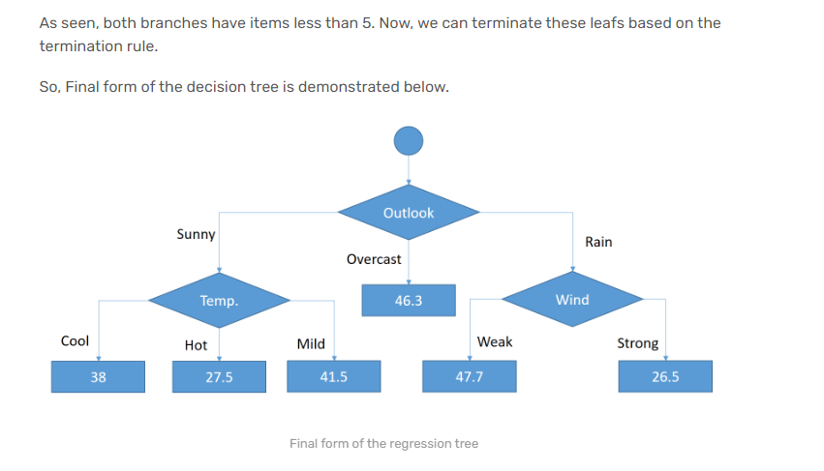

Slide 24
Feature Importance
Feature importance (FI) = Feature metric * number of instances – its left child node metric * number of instances for the left child – its right child node metric * number of instances for the right child

Slide 25
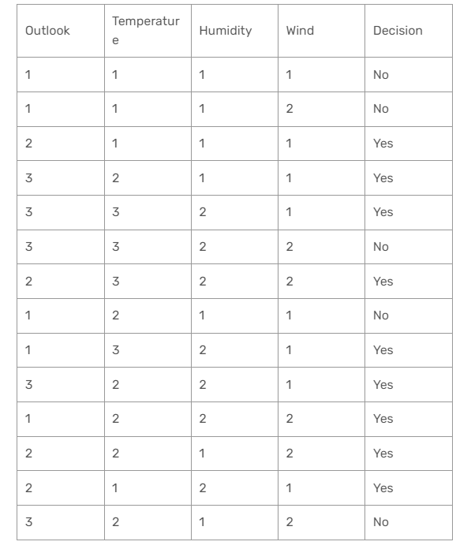
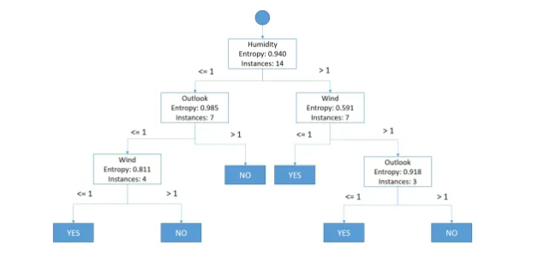

Slide 26
Feature Importance
1st level of the decision tree
FI(Humidity|1st level) = 14x 0.940 – 7×0.985 – 7×0.591 = 2.121
2nd level of the decision tree
FI(Outlook|2nd level) = 7×0.985 – 4×0.811 = 3.651
FI(Wind|2nd level) = 7×0.591 – 3×0.918 = 1.390
3rd level of the decision tree
FI(Wind|3rd level) = 4×0.811 = 3.244
FI(Outlook|3rd level) = 3×0.918 = 2.754

Slide 27
Feature Importance
Results
FI(Humidity) = FI(Humidity|1st level) = 2.121
FI(Outlook) = FI(Outlook|2nd level) + FI(Outlook|3rd level) = 3.651 + 2.754 = 6.405
FI(Wind) = FI(Wind|2nd level) + FI(Wind|3rd level) = 1.390 + 3.244 = 4.634
Normalization
We can normalize these results if we divide them all with their sum
FI(Sum) = FI(Humidity) + FI(Outlook) + FI(Wind) = 2.121 + 6.405 + 4.634 = 13.16
FI(Humidity)’ = FI(Humidity) / FI(Sum) = 2.121 / 13.16 = 0.16
FI(Outlook)’ = FI(Outlook) / FI(Sum) = 6.405 / 13.16 = 0.48
FI(Wind)’ = FI(Wind) / FI(Sum) = 4.634 / 13.16 = 0.35

Slide 28
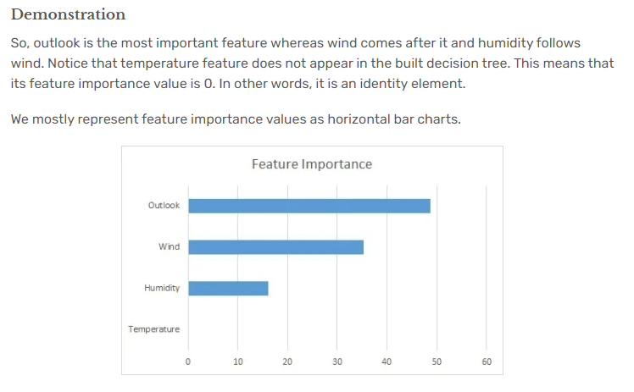
Feature Importance

